Slide 1

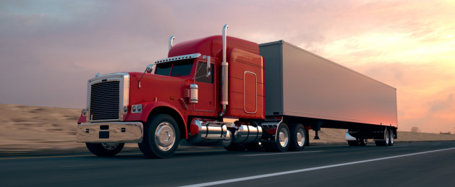




TEAM 3

Slide 2
ANT
About the Company
Objective
Problem Statement
ANT is a 10 year old organization with 400 employees, most of whom are long-distance truck drivers. ANT’s primary business is to provide long distance trucking services of all general and non-specialized cargo types (excluding any HAZMAT cargo) in the western United States ANT has licensure and approval for transport in 14 states
Accidents caused by large trucks remain one of the leading causes of injuries and deaths in the United States. The objective is identifying dangerous commercial truck drivers nationwide
Which truck has the highest risk factor based on geographic location and time?

Slide 3
Work Flow

Slide 4
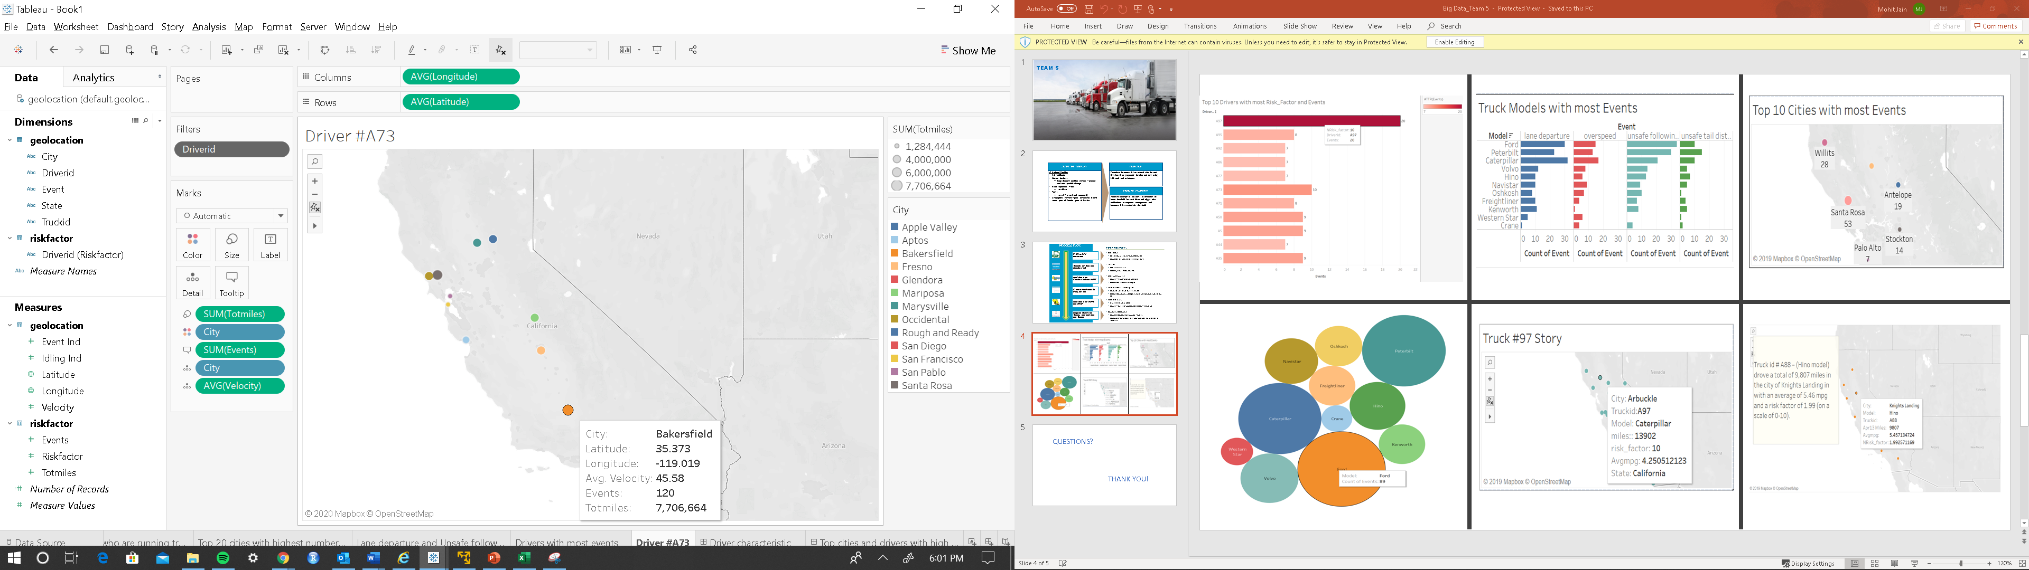
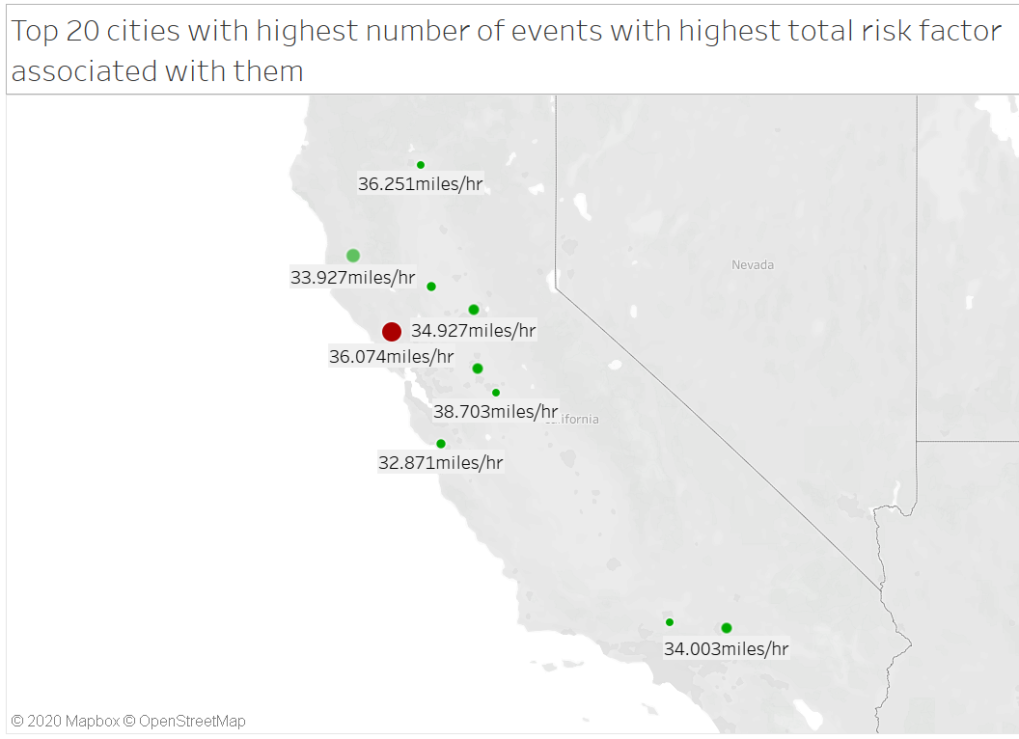
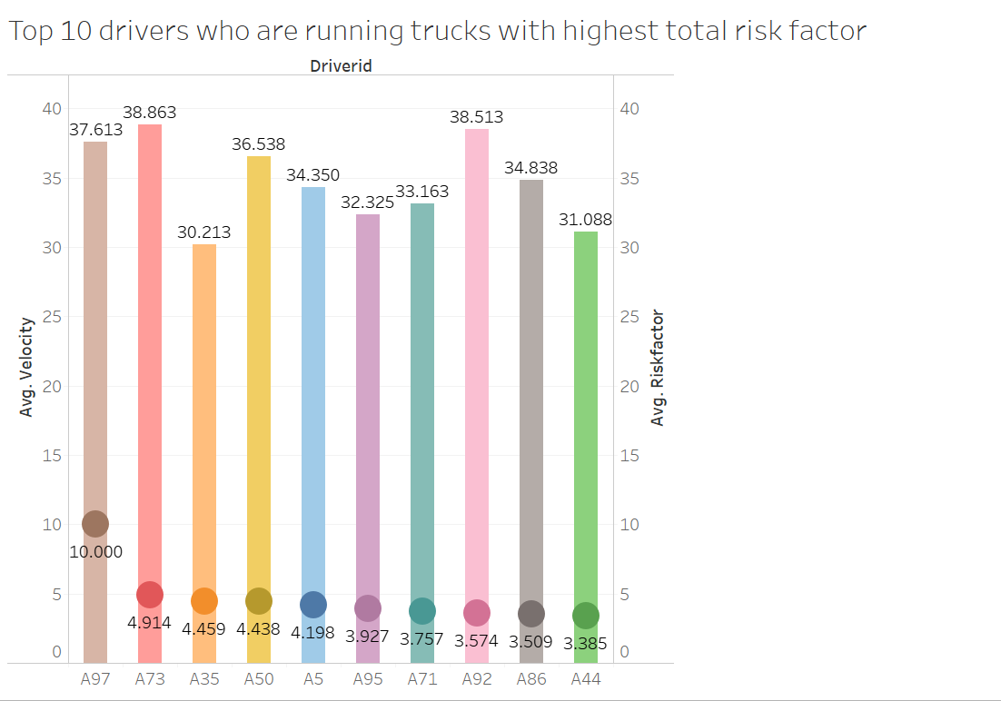
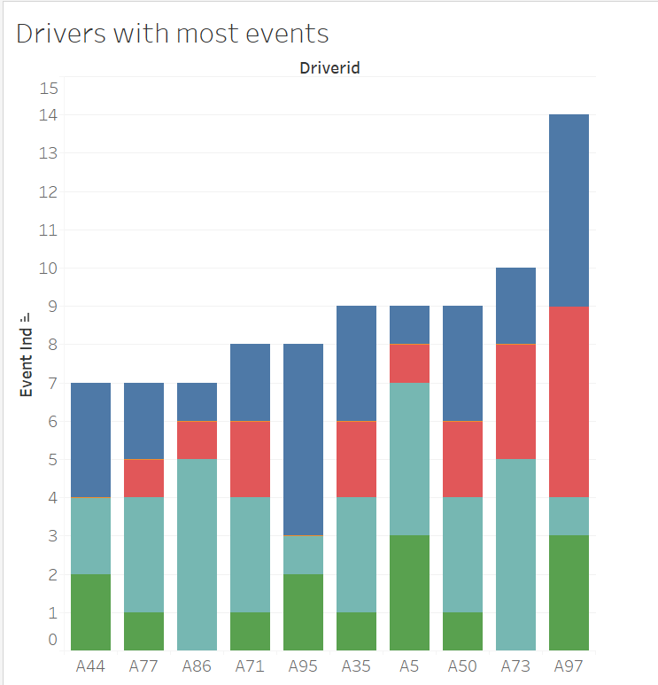
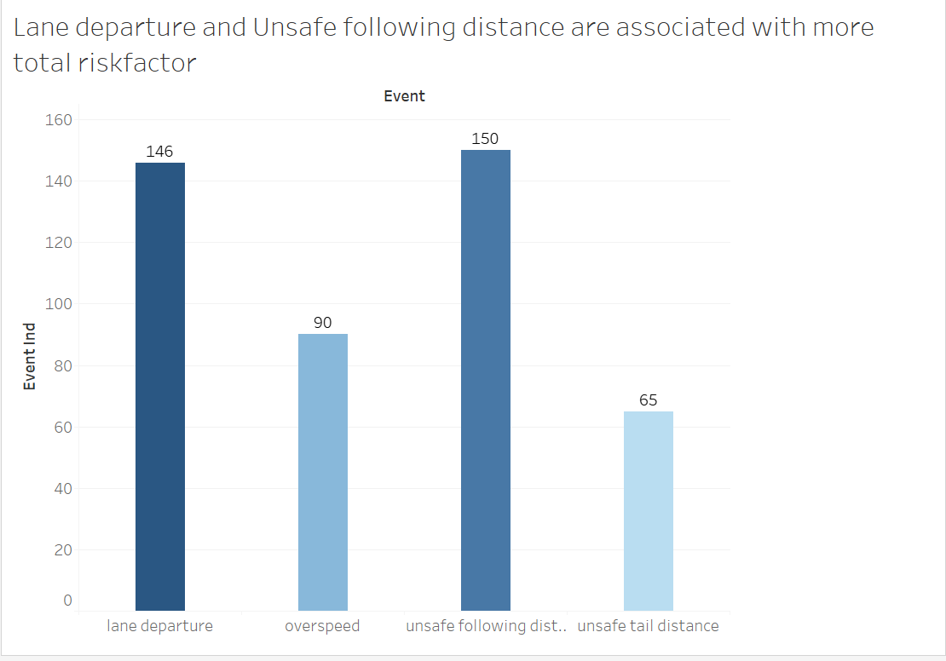

Slide 5
THANK YOU!
QUESTIONS?

